Slide 1


Electronic Submission of a Grade Change from the
Web-based Gradebook
May 2008

Slide 2
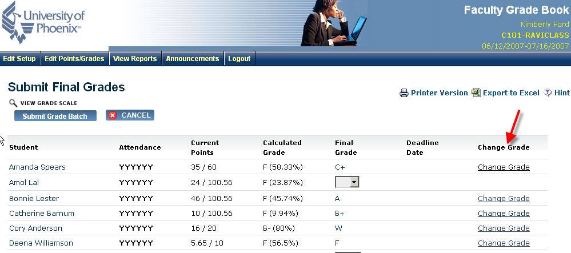
Locate Change Grade Column on the
Submit Final Grades Screen
Screen shots are removed from a demonstration course: actual student grades are not displayed.

Slide 3
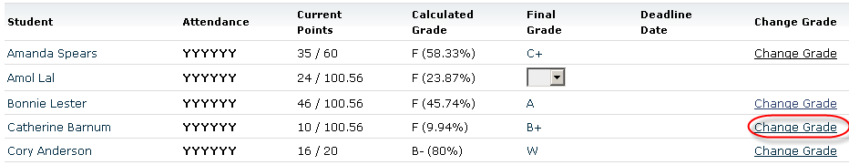
Click link for student whose grade needs to be changed
Screen shots are removed from a demonstration course: actual student grades are not displayed.

Slide 4
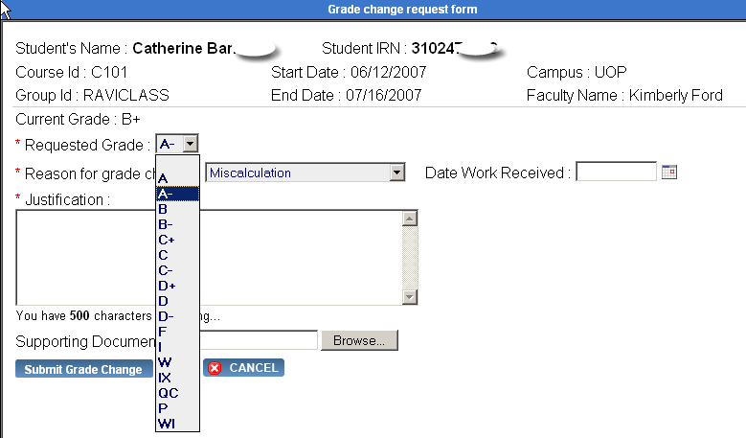
Select New Grade

Slide 5
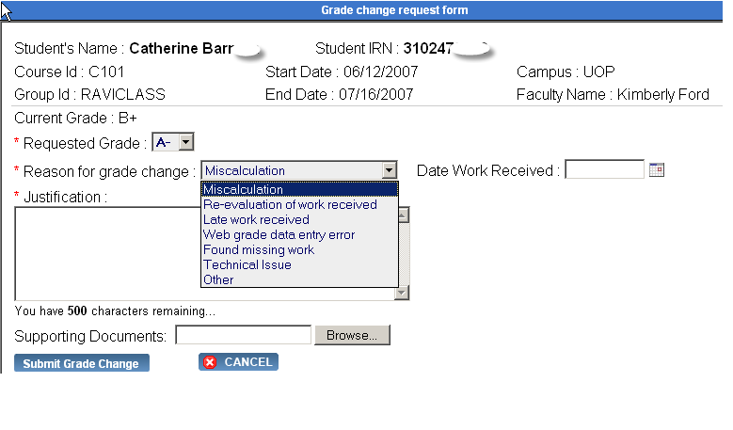
Select Reason

Slide 6
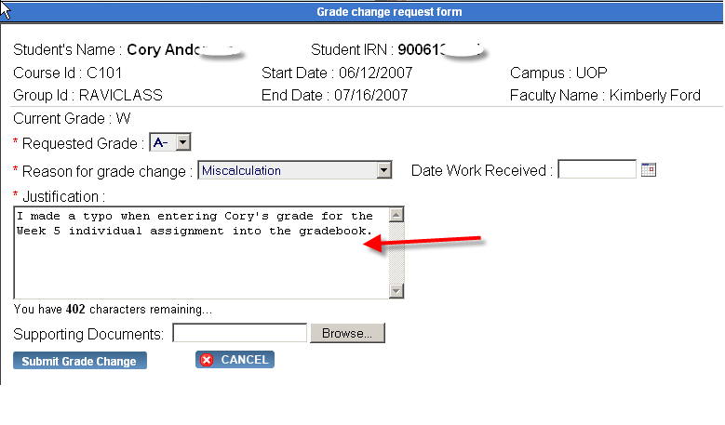
Add Justification (Required)

Slide 7
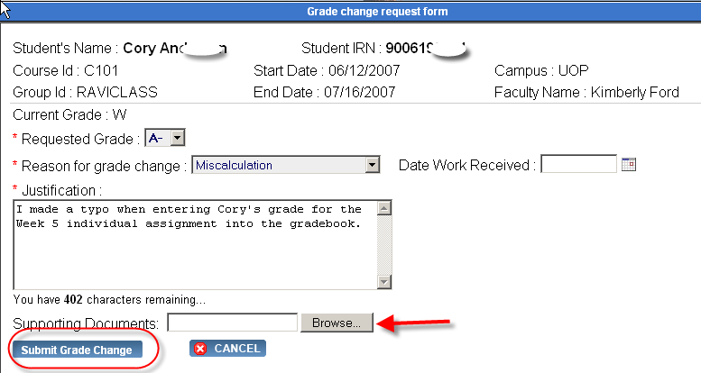
Add Attachments (if necessary)
Submit Grade Change

Slide 8
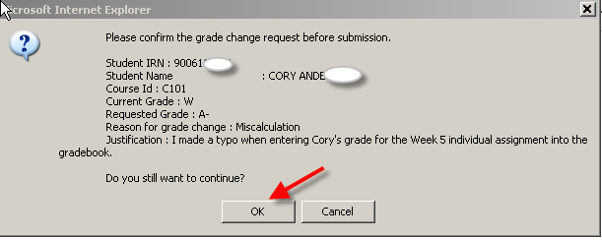
Confirm Information
Click OK

Slide 9
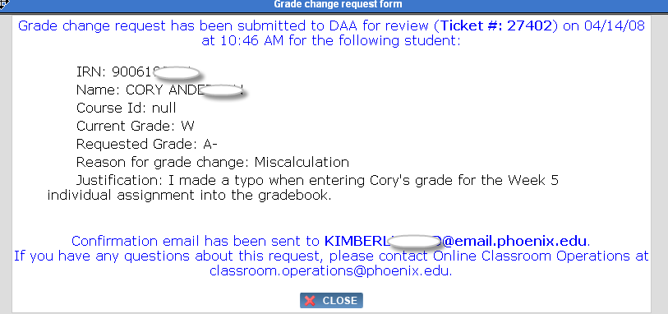
Receive Confirmation
A copy of this on screen message will also be sent to your University email inbox.

Slide 10
Grade Change Reminders
This is a grade change request and is subject to approval of the Campus Director of Academic Affairs.
Grade change requests that occur more than 6 weeks after the class ends are subject to additional levels of approval.
Faculty members are not permitted to accept work after the class is over unless working with a student who was issued an Incomplete (I or IX).

